Slide 1

LUNARCAD
2.0

Slide 2
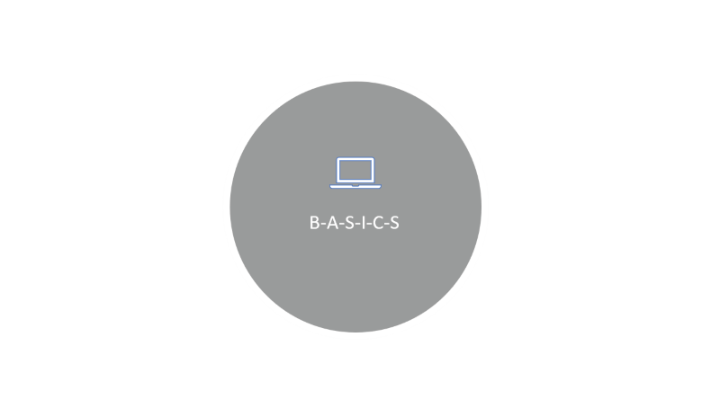
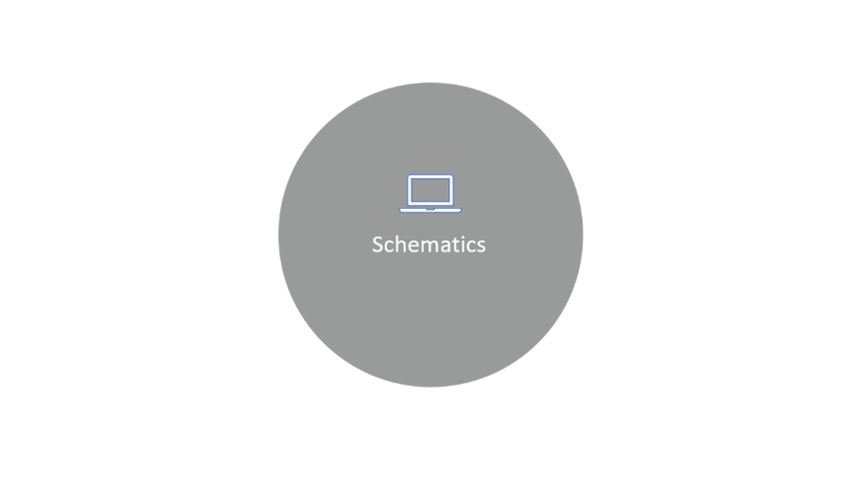
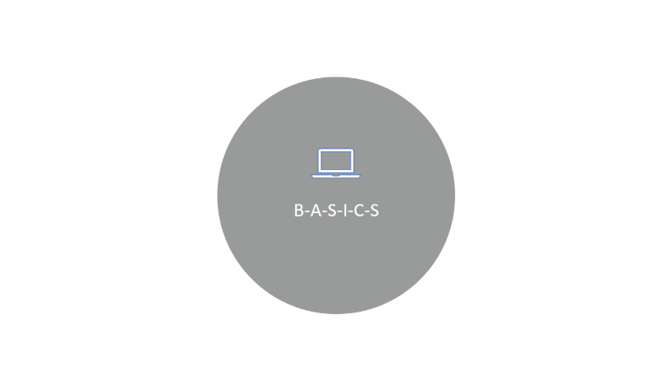
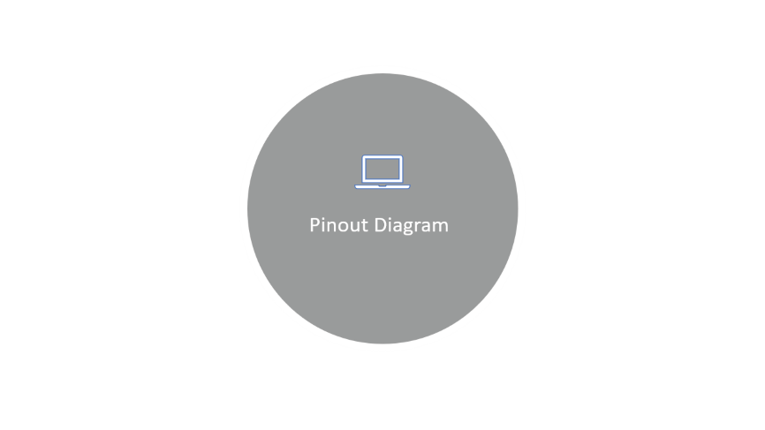
LUNARCAD
2.0

Slide 3

B-A-S-I-C-S

Slide 4
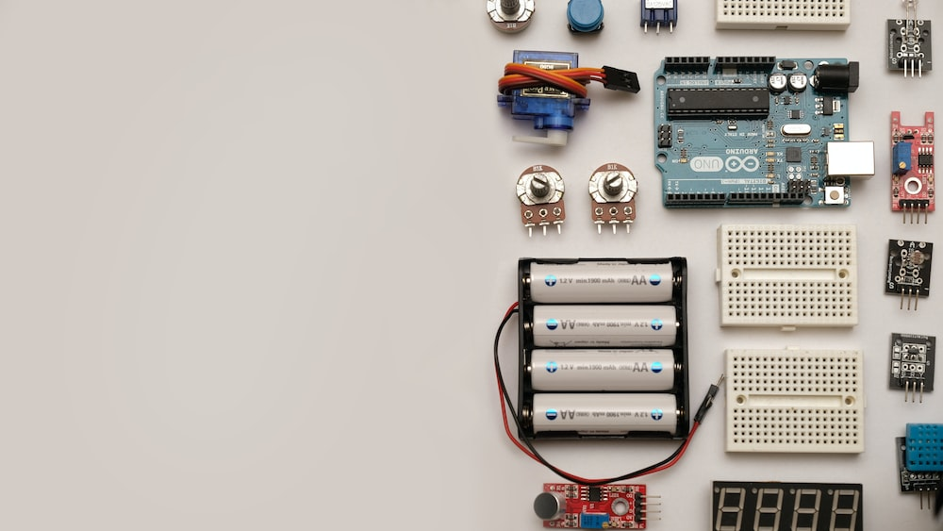
B-A-S-I-C-S
Let’s R-E-W-I-N-D/
Y do we need this there ?

Slide 5
Pinout Diagram

Slide 6
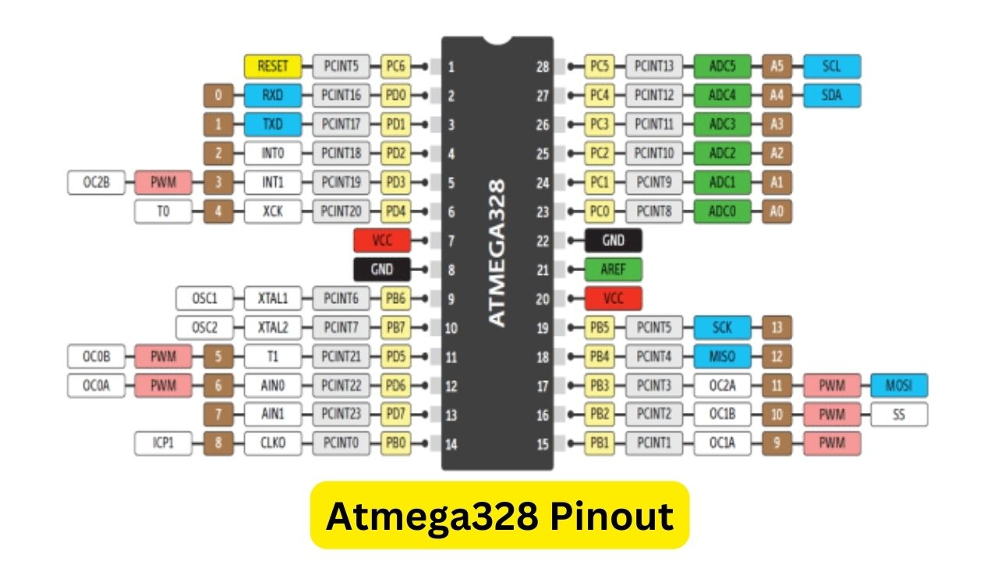
Intro to object oriented C

Slide 7
Schematics

Slide 8
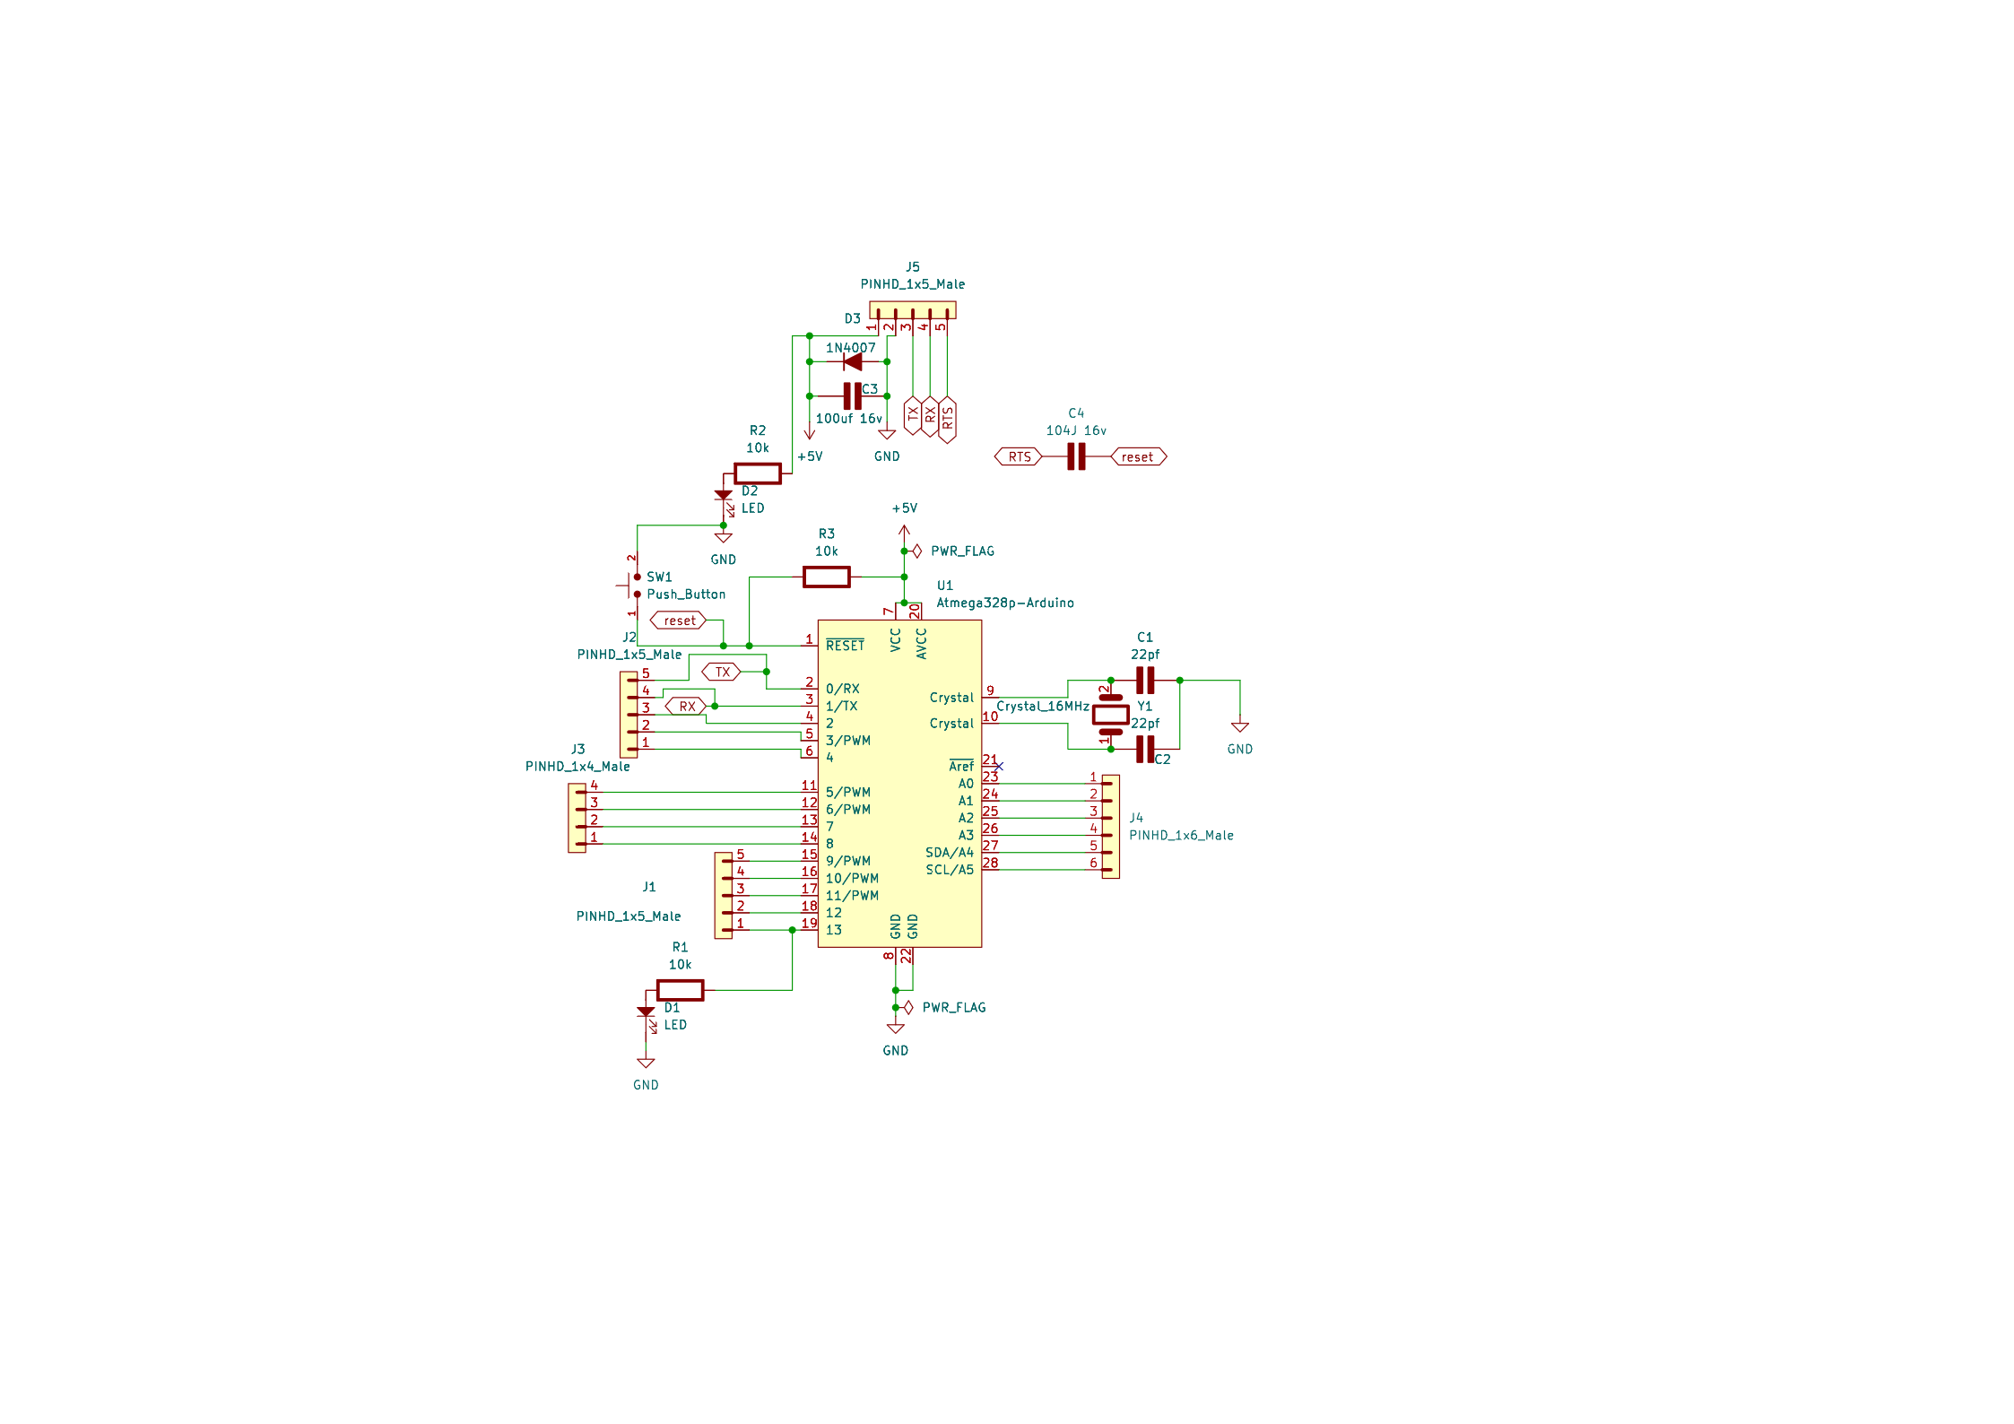
Schematics

Slide 9


Design
Why did we placed that there ?
1N4007 diode : Reverse polarity Protection
Capacitor near diode : input stabilization / add a smaller value if your input is full of noise
104J 16v cap : A 0.1µF capacitor in series between the serial control line (DTR/RTS) and RESET AC-couples the falling edge into a short low pulse on the active-low RESET pin; the 10k pull-up then restores RESET high, allowing an automatic reset for bootloader programming.
Why 22pf capasitor at oscillator ? Why cant it be lower or higher value ?
Atmega 328p used a mechanical crystal ocillators at 16mhz and the capacitors are not filter capasitors bit instead they are Load capacitors
Cl =$\left[\frac{C1∗C2}{C1+C2}\right]+Cstray$
Cstray is from mcu pin ie pin 9 and 10 = 5pf typical
If both are 22pf then by equation Cl= $\left[\frac{22∗22}{22+22}\right]+5=16pF$
Ie 16 pf matches the crystal spec to ocillate at 16mhz
(More detailed calculations coming on the upcoming slides)
If value is smaller frequency will be higher and a big value means lower frequency

Slide 10
What did we avoid from this setup ?
Brown Out circuit (to turn off Atmega at 2v because 3v is the max low limit not necessary but original Arduino has and we want it simple we just avoid it 😁)
Op amp auto power selection (simple you don’t need a single Arduino powering both from 12v input and usb 5v )
Poly fuse (important to avoid unwanted short circuit causing other components to fail )
12v & 3.3v regulation (can be added if you need 12v support to Arduino and 3.3 integration)
Tx and Rx led (total waste 😒)
On-Board USB to Serial (ok but cannot be done on single layer)

Slide 11
Calculation ⚠

Slide 12


Why do we need this auto reset ?
Without auto reset
With auto reset

Slide 13
Calculation alert ⚠
Why?
The ATmega328 reset pin requires a momentary negative pulse, not a permanent LOW.
A 100 nF capacitor provides edge coupling, delivering only the falling edge of RTS to RESET
Reset Circuit Components
Pull-up resistor on RESET: 10 kΩ
Coupling capacitor: 100 nF (104)
Handshake line: RTS or DTR (active LOW)
Together they form an RC circuit, which determines how quickly RESET returns HIGH after the pulse.

Slide 14
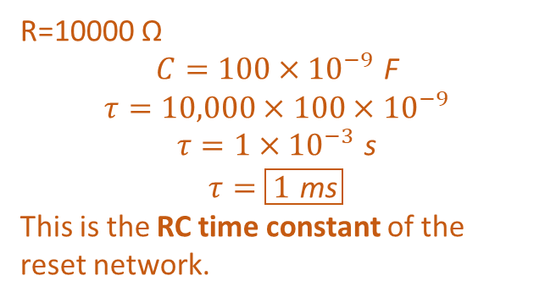

Calculation alert ⚠
RC Time Constant (τ) Calculation
τ=R×C
R=10000 Ω
$$C=100×{10}^{−9} \text{F}$$
$$τ=10,000×100×{10}^{−9}$$
$$τ=1×{10}^{−3} \text{s}$$
$$τ=\boxed{1 \text{ms}}$$
This is the RC time constant of the reset network.
ATmega328 leaves reset when RESET crosses approximately:
$V_{TH}≈0.8 \text{V}$ from data sheet of atmega328.
Solve for time:
$$t=−τ\ln\left(1−\frac{V_{TH}}{V_{CC}}\right)$$
Substitute values:
$$t=−1 \text{ms}⋅\ln\left(1−\frac{0.8}{5}\right)$$
$$t≈0.174 \text{ms}$$
$$\boxed{\text{Actual} \text{reset} \text{pulse} \text{is} ≈174 μs}$$
This is the real reset time seen by the microcontroller.
τ ≠ reset pulse width.
τ is the time needed for RESET to rise to 63% of VCC after being
pulled low.
Why 100 nF is Ideal
Too small → pulse too short; ATmega may not reset
Too large → reset held low too long; bootloader fails
100 nF with 10kΩ = perfect ~170 µs pulse

Slide 15


Slide 16
Let’s DIY

Slide 17
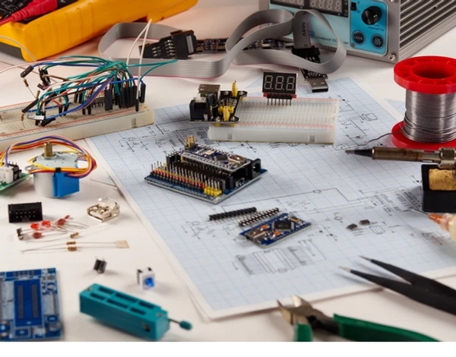
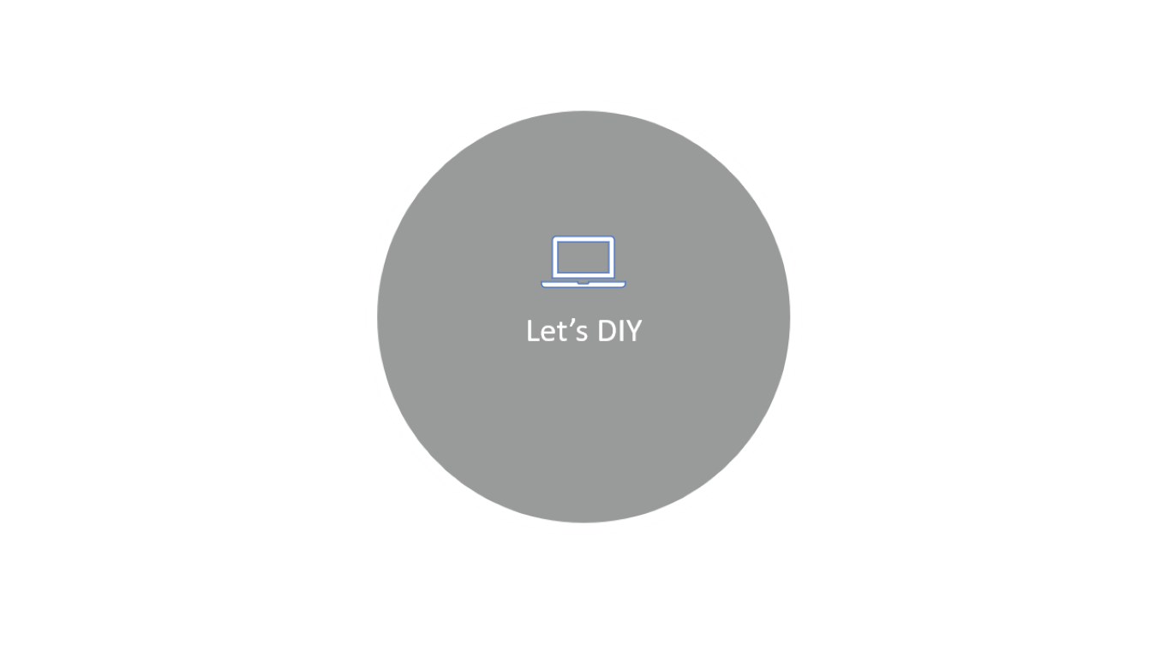

Slide 18
Atmega328 → Atmega328p

Slide 19
Arduino as ISP
Install AVRDUDE
Set fuses and flash boot
Set lock

Slide 20
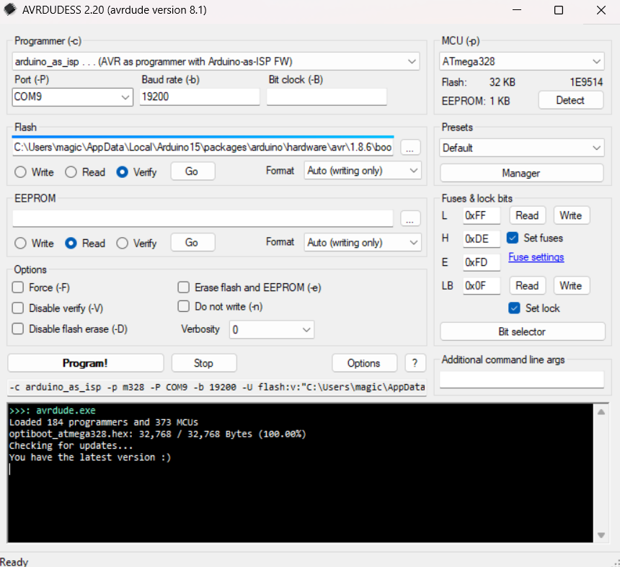
Order of flashing
Set LF,HF,EF fuses
Flash the boot
hex file
Verify flash
Set lock bit fuse

Slide 21
What does each fuses mean ?
L fuse : 0xFF
means now atmega uses 16mhz clock (external) for normal startup
H fuse : 0xDE
meaning Bootloader enabled , and reset pin ok , spi ok and 1kb boot section set up complete
E fuse :0xFD
this sets the brown out voltage for Arduino uno its 2.7v so 0xFD
LB fuse :0x0F
This sets the boot write protection while allowing sketch upload via serial and re-flashing boot via ICSP pins
Follow
L → H → E → boot flash → LB
Only set LB fuse after flashing and verifying the flash

Slide 22
ICSP ?
ICSP : In Circuit Serial Programmer
ICSP needs 6 pins including VCC and GND
MISO : Master in slave out
MOSI: Master out slave in
SCK : serial clock
RESET : Reset input
VCC
GND
Benefits of having ICSP :
flashing firmware without chip removal.
full access to internal fuse bits.
easy debugging.
faster programming .
can program multiple device at once.
Works even when the firmware is bricked or bugged

Slide 23
ICSP pin Connection
PIN NAME | ARDUINO UNO | ATMEGA 328
VCC | 5V | 7/20
GND | GND | 8/22
MISO | D12 | 18
MOSI | D11 | 17
SCK | D13 | 19
RESET | D10 | 1

Slide 24

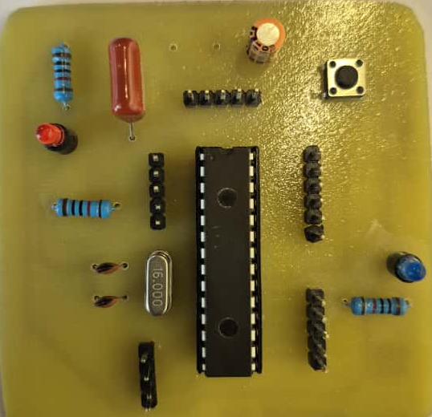
104J RTS
RTS Rx Tx GND VCC
100uf 16v Input Filter
Reset S/W
10K MFR
Power led
Tx Rx D2 D3 D4
A0 → A5
10K MFR
Led → D13/ pin19
Crystal and load capacitors
10K MFR
D13→D9
19 18 17 16 15
D5 D6 D7 D8

Slide 25
Let’s Blink like a pro……
void setup() {
DDRB |= (1 << PB5); // PB5 output
}
void loop() {
static unsigned long lastToggle = 0;
unsigned long now = millis();
if (now - lastToggle >= 500) { // 500 ms elapsed
PORTB ^= (1 << PB5); // toggle PB5
lastToggle = now;
}
}
void setup() {
pinMode(LED_BUILTIN, OUTPUT);
}
void loop() {
digitalWrite(LED_BUILTIN, HIGH);
delay(1000);
digitalWrite(LED_BUILTIN, LOW);
delay(1000);
}

